Slide 1
SOA Enabled Process Transformation
Scaling the IBM FOAK at Gap
March 31st, 2005
Draft 1.0

Slide 2
Discussion topics
SOA FOAK in action at Gap
Potential focal areas for Operations-Led Transformation
How to Scale the SOA FOAK

Slide 3
Business Objective: Improve Labor Efficiency and Utilization
FOAK Project at Gap
Business Process: Distribution Flow Forecasting
Merchandise distribution utilizes large pools of labor resources in the DCs and Stores
Flow forecasting at GAP provides Distribution Centers (DC) and Stores the basis for resource planning
In current state, flow forecasting teams at GAP…
  work entirely on spreadsheets with only little access to both actual historical data and the company wide sales forecasts
  have no means to properly manage and share forecasts within the product divisions
  do not evaluate the quality of their forecast
  rely entirely on manual execution of the business process
Ineffective flow forecasting reduces resource planning efficiency and utilization of labor resources
In addition, allocating product to stores where it is under-productive erodes net margins… measuring forecast accuracy could lead to improved efficacy

Slide 4
FOAK work steps
Step One: Understand the concerns of the business
  What is the business strategy?
  What are the business objectives and how are they measured?
Step Two: Understand how the business currently works to achieve those goals (Business Operations Modeling)
  What is the business producing? (What are the key business documents? What do they contain?)
  How are they producing it? (How are the key business documents passed from one role player to the next?)
  What are the performance gaps? (Where are the breakdowns in business effectiveness and efficiency?)
Step Three: Understand how IT can enhance information operations to support improvements in business performance (Information Operations Modeling)
  What are the key information sources?
  What are the key information processes?
  How do business users access and input information in the context of the processes?
  What metrics are needed to evaluate the performance of the processes?
Step Four: Enhance business operations support
  Develop lightweight IT solution artifacts to improve the efficacy of existing core IT applications
  Deploy solution with pilot user group
  Refine solution artifacts
  Scale solution to wider user groups
Step Five: Continuous process improvement
  Extend solution artifacts to include users in related business functions
  Monitor business performance, and identify additional improvement opportunities
  Repeat Steps Three & Four (Some improvements at this point may require new IT applications)

Slide 5
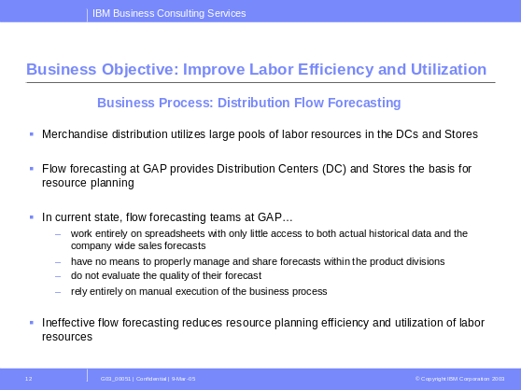
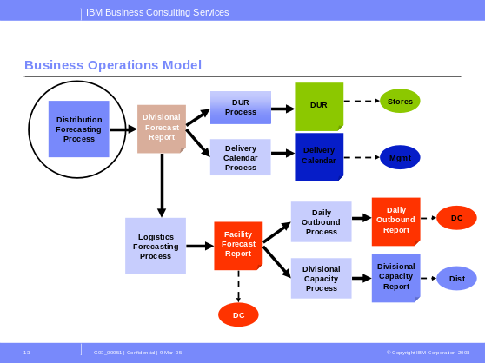
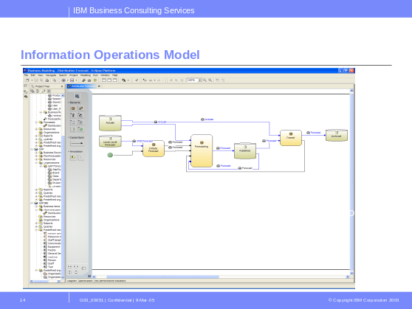
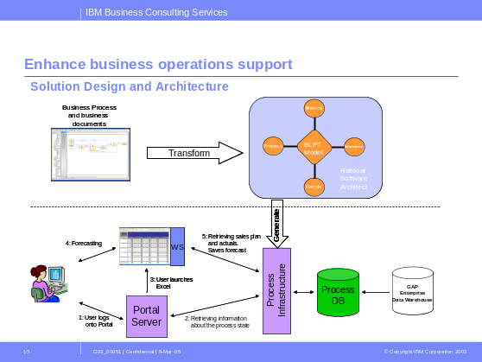
Key activities of the Distribution Flow Forecast Project
Step One: Understand the concerns of the business
(elapsed duration 2 work days)
Step Two: Understand how the business currently works to
achieve it’s goals (elapsed duration 5 work days)
Step Three: Understand how IT can enhance information operations to support improvements in business performance (elapsed duration 20 work days)
Step Four: Enhance business operations support (elapsed duration 30 work days)

Slide 6
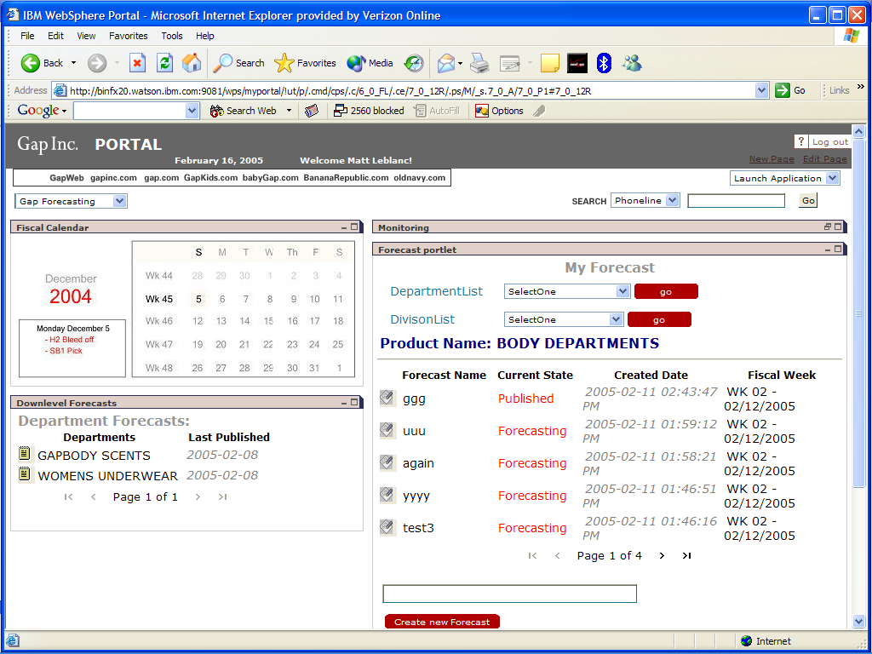
Release 1 (working pilot) : Gap Kids Distribution Flow Forecasting Tool (achieved in 57 work days)
Distribution flow forecasts are now accessed thru a web portal
Data pull from the data warehouse is now automated
Excel spreadsheets still used as the decision support tool
Automated data push to target systems when the spreadsheet is closed
Flow forecast rollup across division is now integrated/automated
Forecast accuracy can be measured/monitored to achieve business improvement targets

Slide 7
Enabling technologies utilized in the FOAK
WBI Server Foundation 6x
WBI Modeler
Rational Application Developer
Rational Solution Architect

Slide 8
Business Benefits from Flow Forecasting Project
Optimize the flow forecasting business process…
  by providing the right data at the right time
  by supporting various forecasters with different responsibilities to collaborate and to share forecast related information
  by managing forecast data consistently
  by monitoring the quality of the forecast by evaluating relevant KPI’s
Process Effectiveness: Improve the quality of the forecast
  DC’s plan within a 15% bracket off the monthly forecast for a given product. (i.e. forecasters can adjust they weekly forecast up to 15% till end of the month to account for forecast inadequacies)
  Reducing the variability bracket to 10% will save Gap Kids approx $1M in labor cost
Process Efficiency: Streamline and automate the business process resulting in significant reduction in time and resources
“Typically we need a year to see the kind of benefits this project has delivered in two months” – Gap Business Leader on the Distribution Flow Project

Slide 9
Additional benefits
Business Agility
  Reducing the gap between Business Requirements and IT solutions delivered
  Reducing the process design and development time
Process Improvement
  Increasing the effectiveness of the business process prior to implementation
  Reduce errors associated with manual processes
  Providing a common process framework
  Horizontal Process Integration across functional silos
Process Visibility
  Monitoring Key Performance Indicators
  Notifying process owners of changes in KPIs and process exceptions
  Correlating and managing complex events across processes & systems
Process Adaptability & Evolution
  Closing the loop: model, integrate, monitor, adapt
  Evaluate multiple variants of the process in real-time & promote high performing ones

Slide 10
Discussion topics
SOA FOAK in action at Gap
Potential focal areas for Operations-Led Transformation
How to Scale the SOA FOAK

Slide 11
The SOA/FOAK approach could be applied to business change initiatives in other areas of Gap
Gap International C-to-C (sp) project
Merchandising and Planning Process Improvement in other Gap Inc. Brands
Gap, Inc. Product Lifecycle Management

Slide 12
Discussion topics
SOA FOAK in action at Gap
Potential focal areas for Operations-Led Transformation
How to Scale the SOA FOAK

Slide 13
Scaling the FOAK involves around establishing an SOA project office in Gap IT
Skill Sources
PMO Domain
Project Domain
Gap IT
Project
A
Gap
Strategy &
Planning
SOA
project office
Project
B
IBM
BCS/AIS
(onshore)
Project
C
IBM
AMS
(offshore)
Standards & governance
Managing project slate
Skill sourcing
Asset reuse
Information modeling
Application development & maintenance
Business strategy
Operations modeling
Metrics & measurement
Continuous improvement

Slide 14
Work steps for scaling the SOA/FOAK capabilities
Work Steps | Time Frame | TCV $ Approx
Establish SOA Project Office Standards, governance and procedures Set-up tools and teams for pilot projects | 2Q – 3Q 2005 | $500-750K
Complete Flow Forecasting pilot plus two additional pilots International expansion (?) PLM (?) | 2Q – 4Q 2005 | $250 – 350K
Develop 2006 Project Slate Work in conjunction with Gap planning process (Tom McKay, Brands, etc) | 2Q – 4Q 2005 | ?
Execute 2006 Project Slate | 2Q 2006 – 4Q 2007 | $xM

Slide 15
Challenges to scaling the SOA/FOAK at Gap
While the tools employed are all commercially supported (by end of calendar year 2005), the skills and experience with the tools and methodology are limited within IBM and Gap
Gap FY 2005 budget constraints

